Slide 1
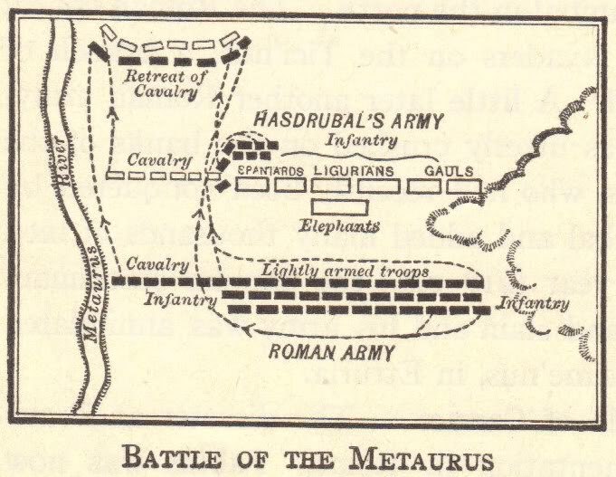
The Punic Wars (264-146 B.C.E.)
© Student Handouts, Inc.
www.studenthandouts.com

Slide 2
What was Carthage?
Powerful city located near present-day Tunis, Tunisia, along the Mediterranean coast of Africa
  Phoenician colony founded in the 8th century BCE
  Punic is Latin for Phoenician
Carthage had a large commercial empire
  Great harbor at Carthage
  Phoenician tradition of sailing and trading
  Controlled trade in the western Mediterranean
  Carthaginian trading empire spread to islands of Corsica, Sardinia, and western Sicily, along with southern Iberian peninsula (modern-day Spain)
Major rival of Rome

Slide 3
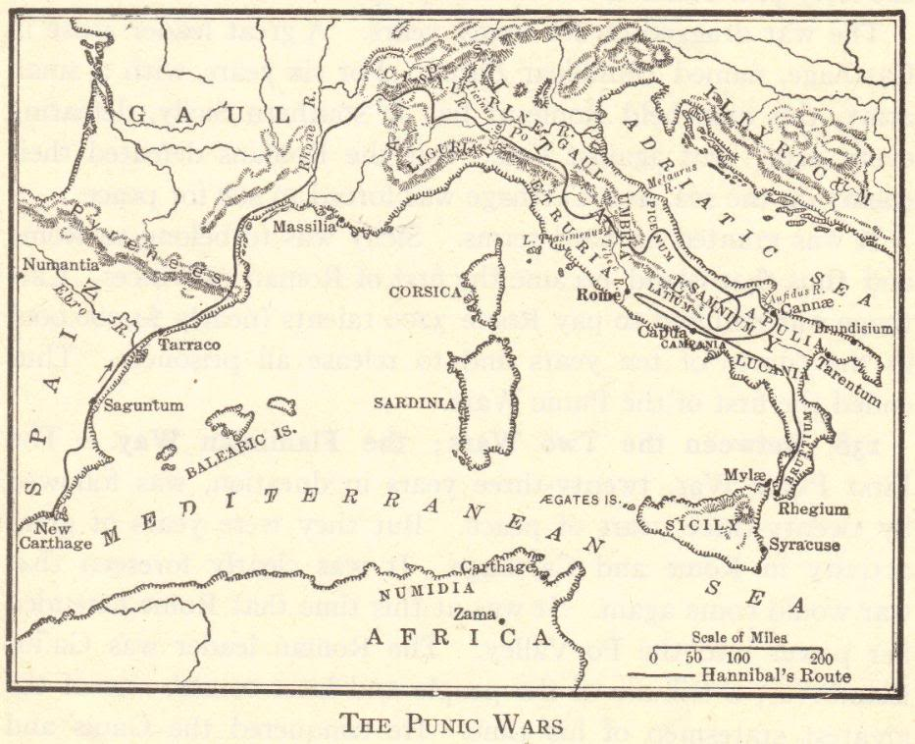

Slide 4
Where did Carthaginian power lie?
Navy
  Very large
  Phoenician sailing tradition
Army
  Mercenaries (hired soldiers)
Government
  Oligarchy – ruled by the wealthy elites (those made rich through trade)

Slide 5
How many Punic wars were there?
1st
264-241 BCE
Fought over Sicily
2nd
218-201 BCE
Rome challenged Carthaginian expansion in Iberia (Spain)
3rd
149-146 BCE
Rome attacked Carthage and obliterated the threat for good
Rome won
Rome won
Rome feared Carthage was again becoming a threat

Slide 6
First Punic War (264-241 BCE)
Carthage and Rome fought for 23 years over control of Sicily
Strengths
  Roman strength – army
  Carthaginian strength – navy
Rome’s solution – build up its navy
  Built four fleets, each destroyed in turn, before mastering naval warfare
Rome’s new weapon – grappling hook
  Lashed ships together
  Forced ship crews to fight one another on deck
    Hand-to-hand fighting was a Roman strength
Rome won – Sicily became a province of Rome

Slide 7
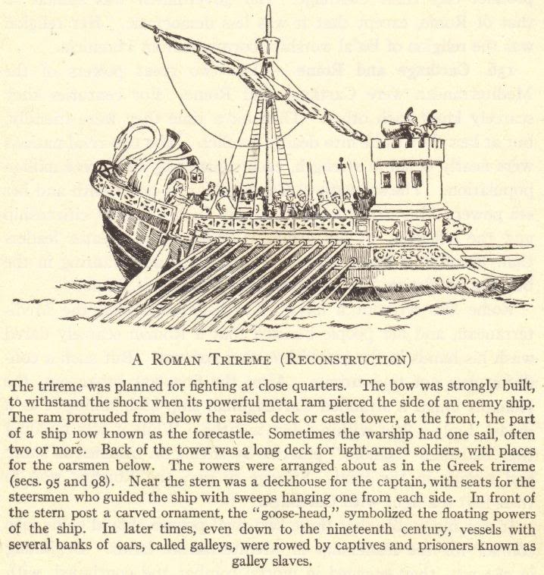

Slide 8
In the meantime…
Rome
Rome came to control Corsica and Sardinia
Rome conquered the Gauls of the Po River Valley
Carthage
Carthage recovered from its defeat by Rome
Carthage started expanding in Iberia (Spain)

Slide 9
Second Punic War (218-201 BCE)
Carthage: General Hannibal
Rome: General Scipio
Led an army against Carthaginian Iberia (Spain)
Led 60,000 men and dozens of elephants through Spain, along the Mediterranean coast, through Gaul, and across the Alps to Italy
Fought in Italy for 15 years, winning many battles
Battle of Cannae (216 BCE)
Romans lost over 50,000 soldiers
But Hannibal could not capture the city of Rome
Then led an army against Carthage itself
Then returned to Italy to defend the city of Rome
Battle of Zama (202 BCE)
Hannibal’s first and only defeat
Hannibal escaped and returned to Carthage
Carthage lost its fleet, Iberia (Spain), and the larger part of its territory in northern Africa

Slide 11
207 BCE – Battle of the Metaurus
Pivotal battle of the Second Punic War
Hannibal’s brother, Hasdrubal, was bringing supplies and equipment to his brother for the siege against Rome
Consul Marcus Livius was reinforced when Consul Gaius Claudius Nero brought troops via a forced march
Carthaginians were outnumbered and Hasdrubal was defeated
Consul Gaius Claudius Nero severed the head of Hasdrubal and had it thrown into Hannibal’s camp as a threat

Slide 12
In the meantime…
Carthage
Carthage rebuilt its trading networks and commercial power
Rome
Rome felt threatened by competition from Carthage
Senator Cato ended all of his speeches with the warning: “Carthago delenda est!” (“Carthage must be destroyed!”)

Slide 13
Third Punic War (149-146 BCE)
Rome made ridiculous demands of Carthage
Carthage refused
Carthage had no mercenaries
Romans laid siege to Carthage
Roman siege was successful
300 noble children to be given to Rome as hostages
Carthage to be destroyed and rebuilt away from the coast
Forced to defend their own city
Romans burnt Carthage to the ground – became Roman province
Men killed; women and children sold into slavery

Slide 14
Results of the Punic Wars: During and After
Rome and Carthage had been what you might call the “superpowers” of the Mediterranean at the time
Roman control of Macedonia
Rome went on to conquer the remnants of Alexander the Great’s empire in Eurasia
Rome’s defeat of Carthage left Rome as the only remaining “superpower”
It was much easier for Rome to conquer the rest of the Mediterranean once Carthage was out of the way
Hannibal had made an alliance with the Macedonian king
Rome attacked and defeated Macedonia in 197 BCE
Fighting among the Greek city-states
Rome took over, ending Greek independence (146 BCE)
Kingdom of Pergamum
In modern-day Turkey
Under Roman rule in 133 BCE

Slide 15
Provincial Governments
Each conquered area was a province of Rome
  Proconsuls
    Each province was governed by a Roman proconsul
    Typically a member of the patrician (noble) class
    More often than not these were corrupt
  Publicans
    Publicans were tax collectors
    Became a publican by auctioning for the job
    Squeezed as much money out of conquered peoples as they could

Slide 16
Rome Grows Wealthy
Money (from taxes and war booty) and cheap goods flooded Rome
Upper classes grew wealthier, and new class of wealthy merchants and traders emerged
Government had more money than ever before
Whoever controlled the government could use this money for its own needs (e.g., government contracts)
Africa and Sicily – wheat
East – gems and luxury goods
Spain – silver and tin
This caused greater tension in the struggle for control of the government

Slide 17
Old Roman Values Diminish
Roman Army
Originally, it was staffed by volunteers
Professional army lacked the former volunteer fighting spirit
Morals and Values
Corruption replaced dedication to public service
Pursuit of luxury, pleasure, and soft living replaced hard work, patriotism, and simplicity

Slide 18
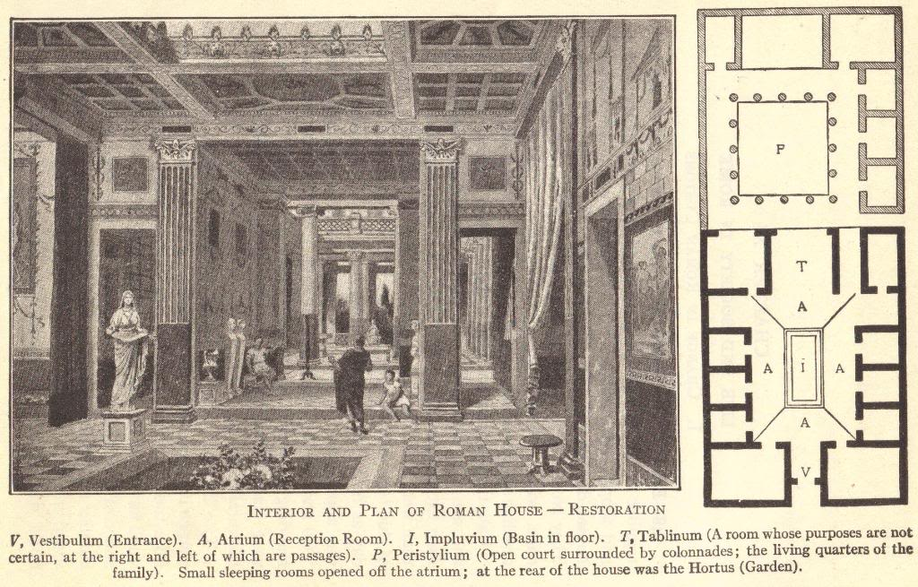

Slide 19
What did expansion mean for Rome?
Pros
Wealth
Power
Cons
Difficult to manage an empire
Wealth created new classes in Rome
From trade
From taxes
Multicultural empire required a multifaceted approach
Slaves gained by conquests displaced free farmers and workers
These problems ultimately ended the “Republic” and led to the “Empire”
Control of most of the Mediterranean

Slide 20
Rich Get Richer, Poor Get Poorer
Money from government contracts (building bridges, roads, and ships; supplying the armies)
High-interest loans
Bribes and graft in the provinces
Poor farmers and workers could not compete with the products of slave labor
Wealthy class bought up the lands of impoverished farmers
Impoverished farmers and others flooded the city of Rome
Latifundia, the large farms of the wealthy, became operated by slaves
These unemployed masses had one thing left—their right to vote
These unemployed masses—the “Roman mob”—threw their support to those politicians who offered “bread and circuses”

Slide 21
Review Questions
Where was the city of Carthage located?
What was the basic, underlying cause of all of the Punic wars?
Describe the military actions of Hannibal.
Why was it easier for Rome to expand following the defeat of Carthage?
How did Rome grow wealthy as its territory expanded?
How was the “Roman mob” created?

